Slide 1
Working code / software screenshots Iteration 4
Jackson Davis, Sanya Sinha, David Woolston

Slide 2
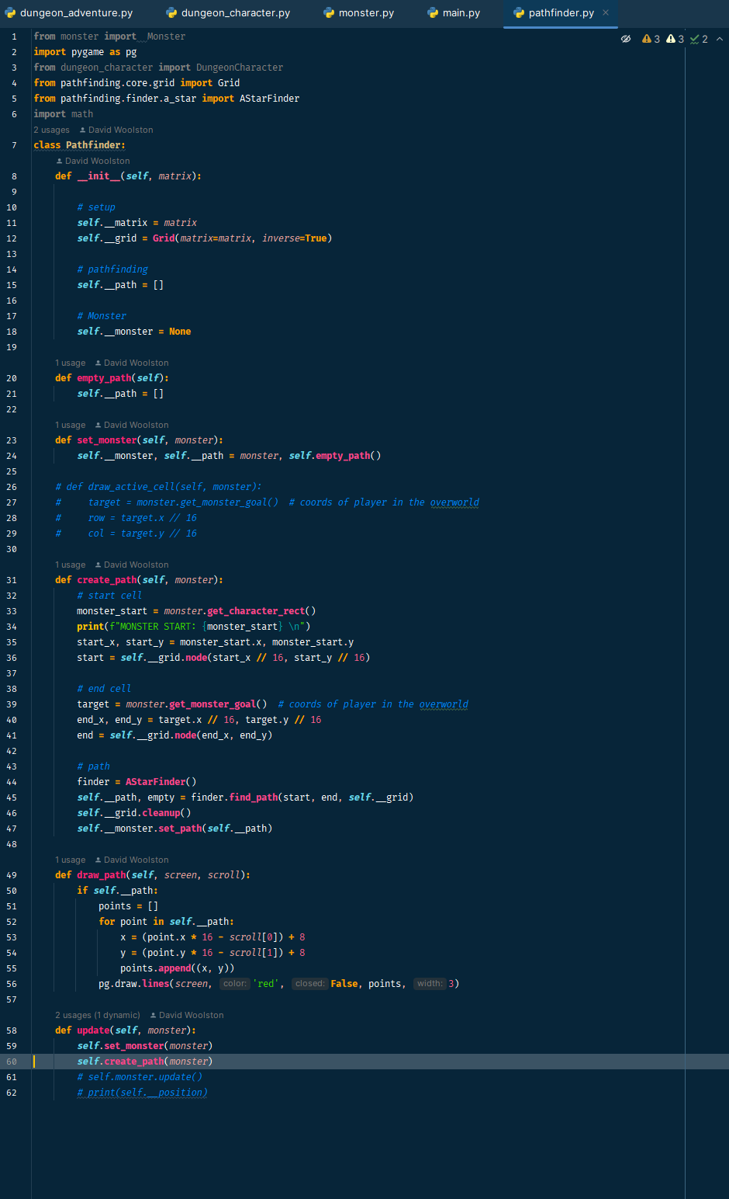
Pathfinder class code

Slide 3
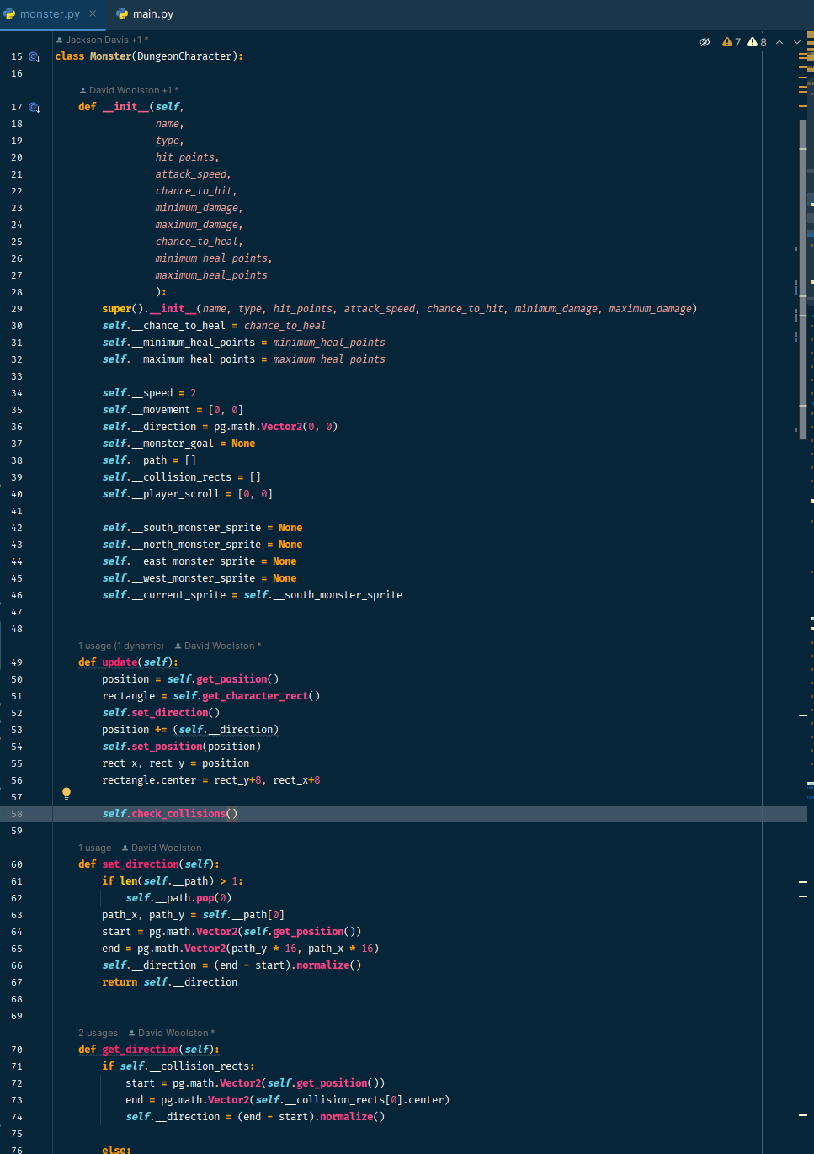
Monster pathfinding code, completed

Slide 4
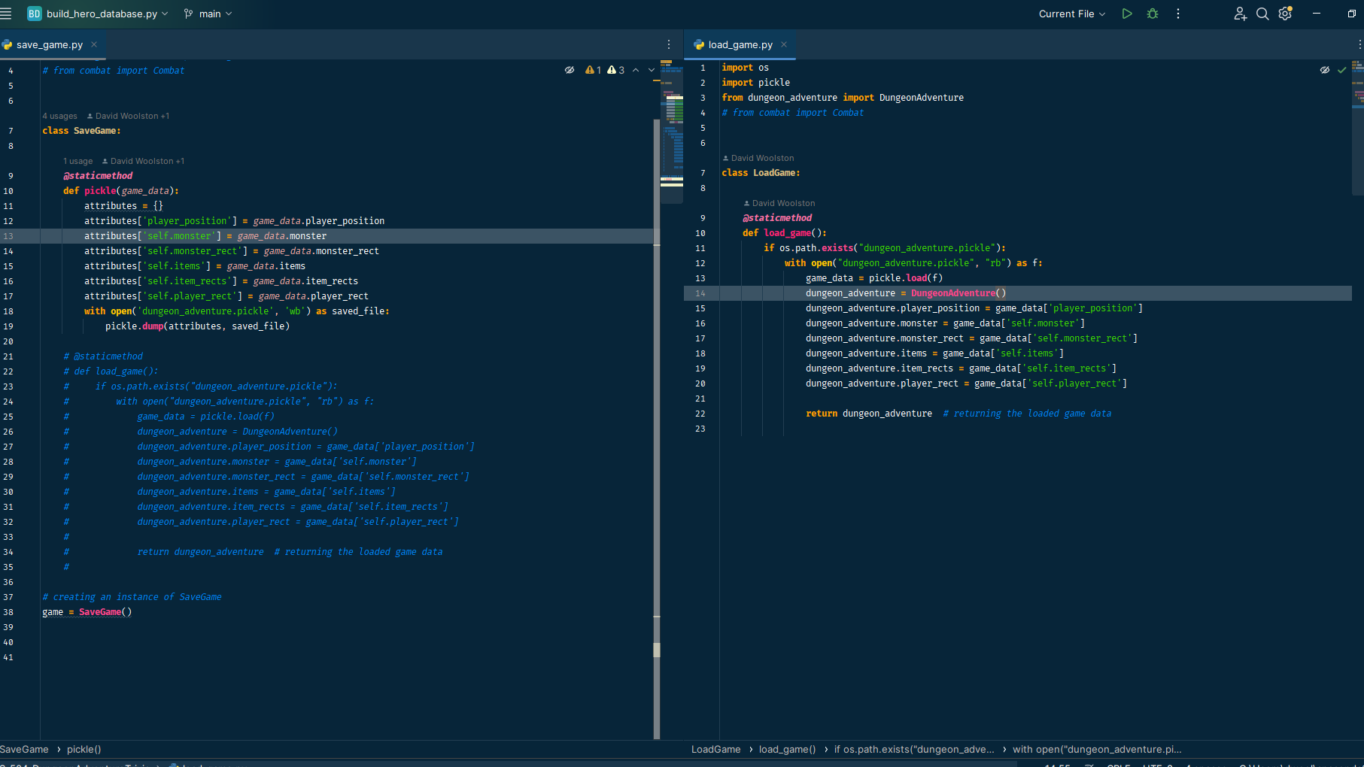
SaveGame and LoadGame

Slide 5
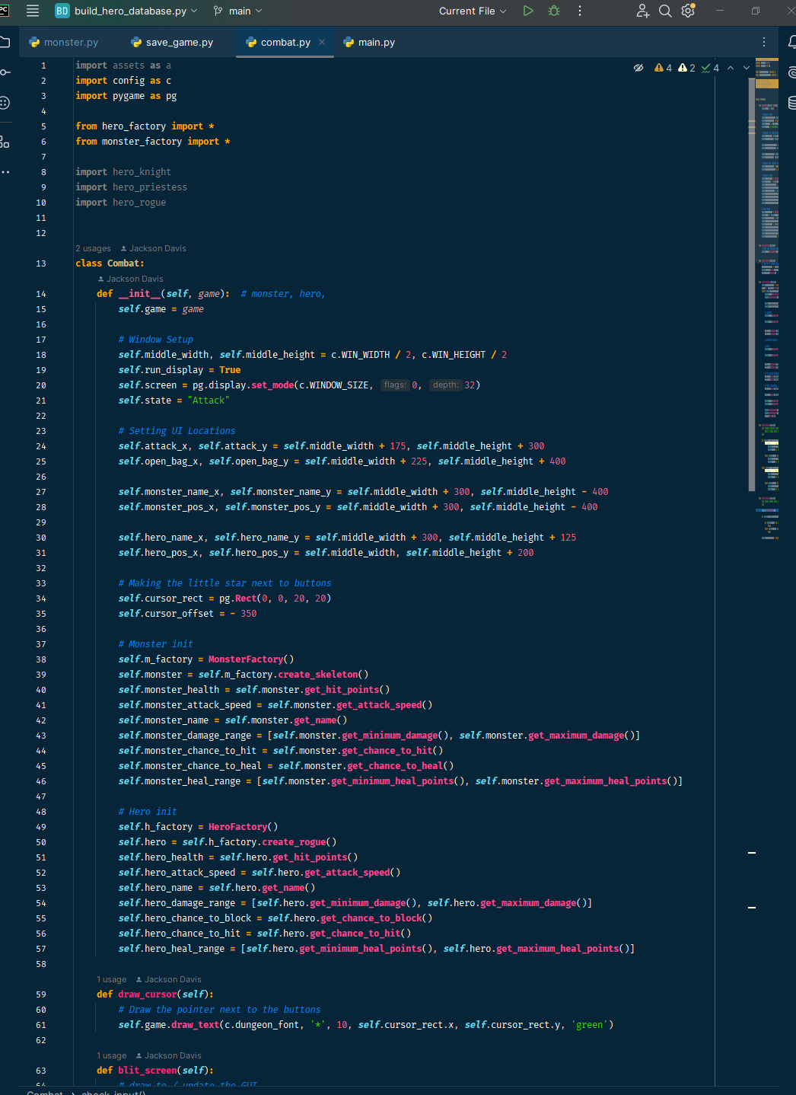
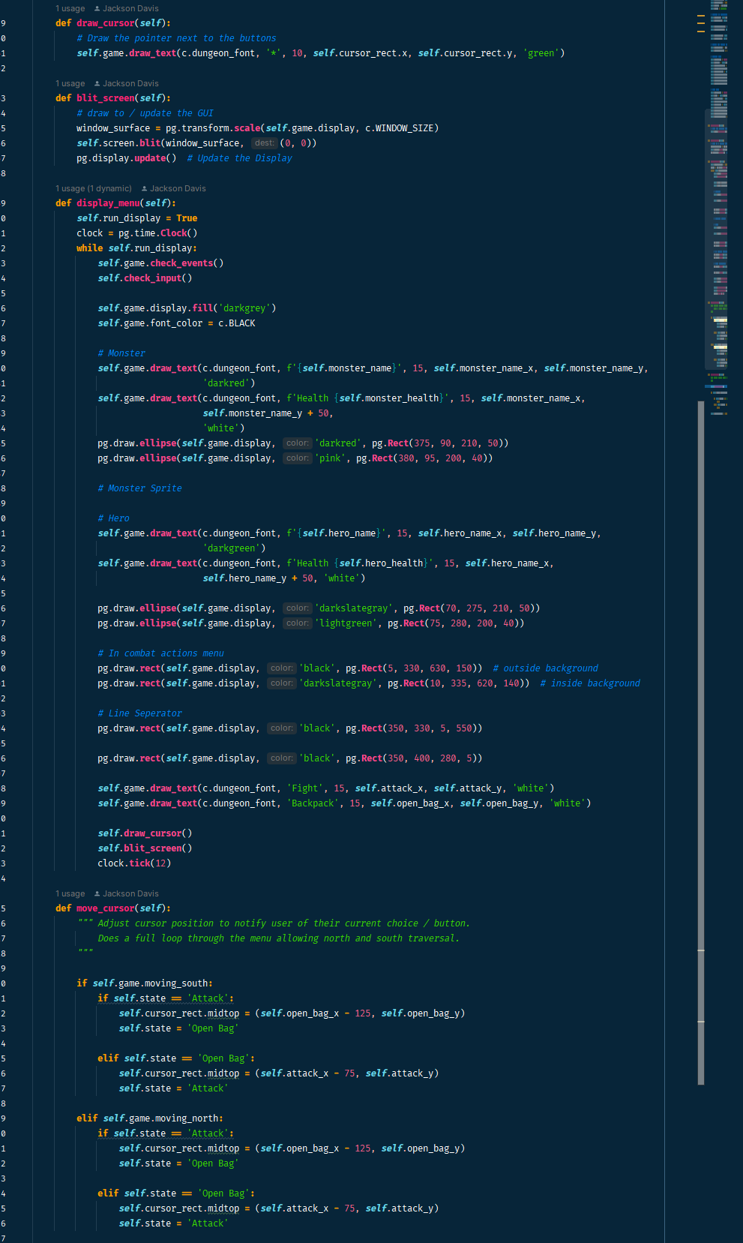
Combat

Slide 6
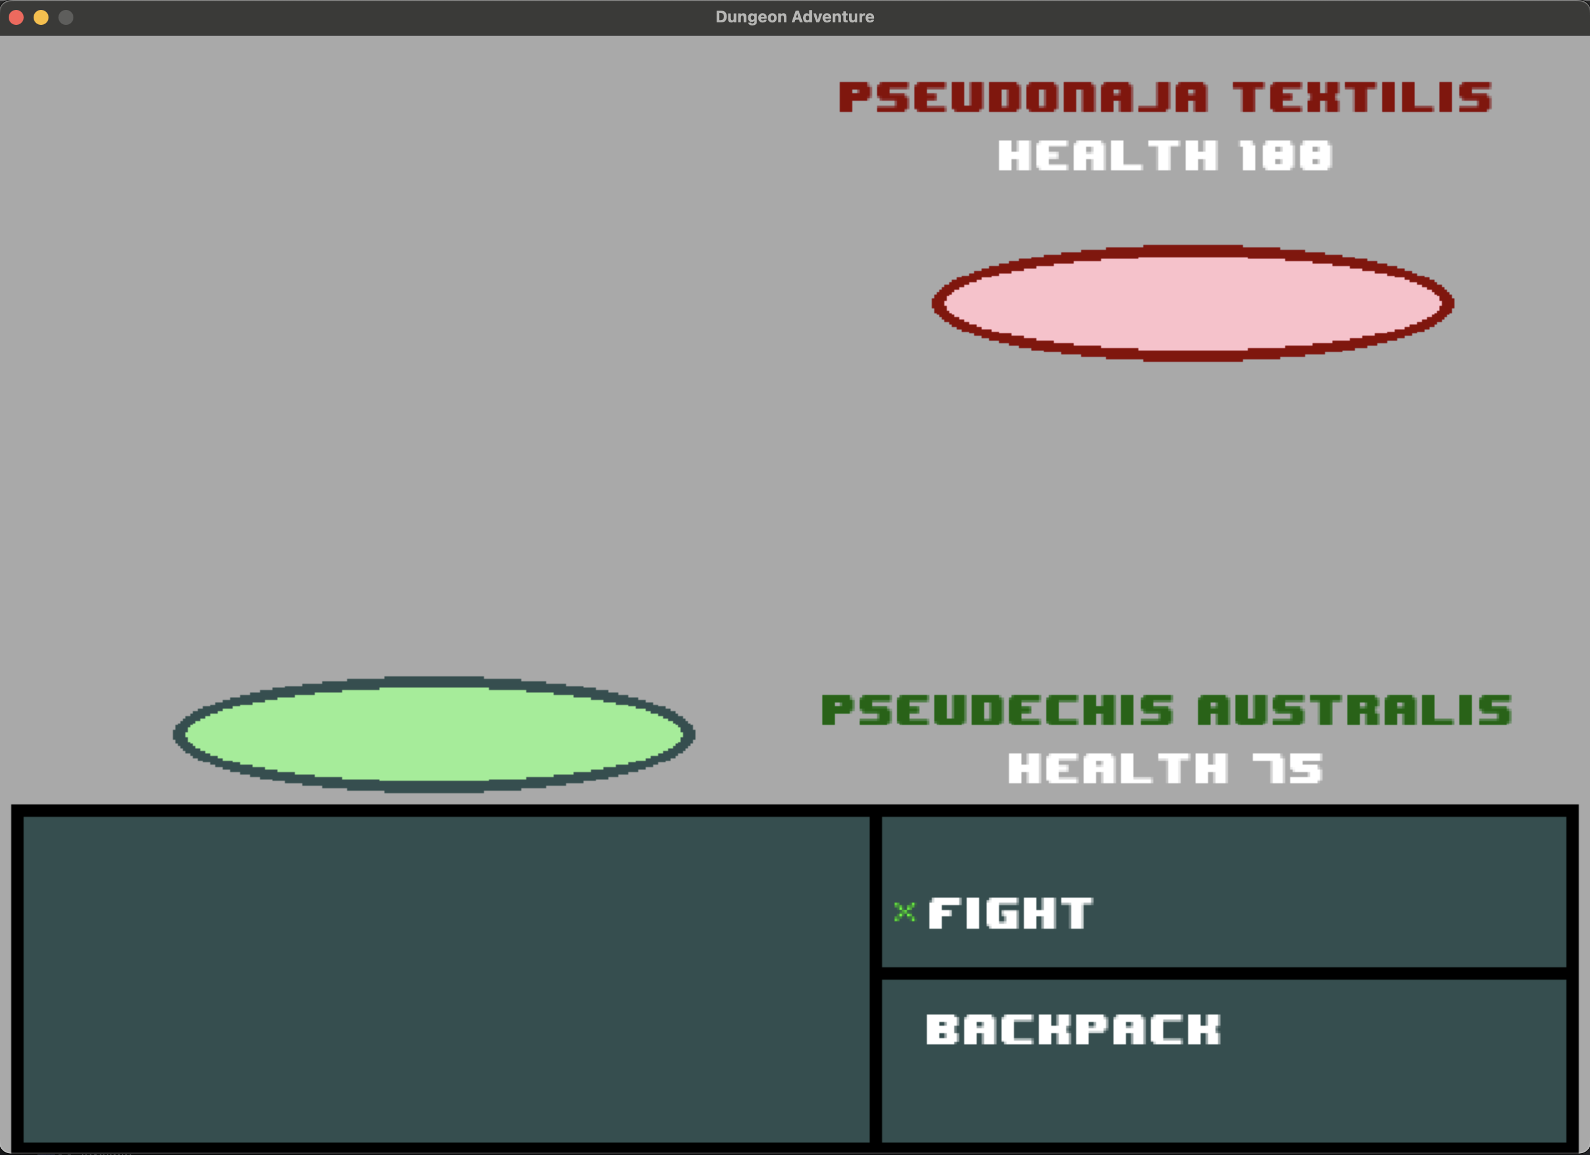
Combat GUI

Slide 7
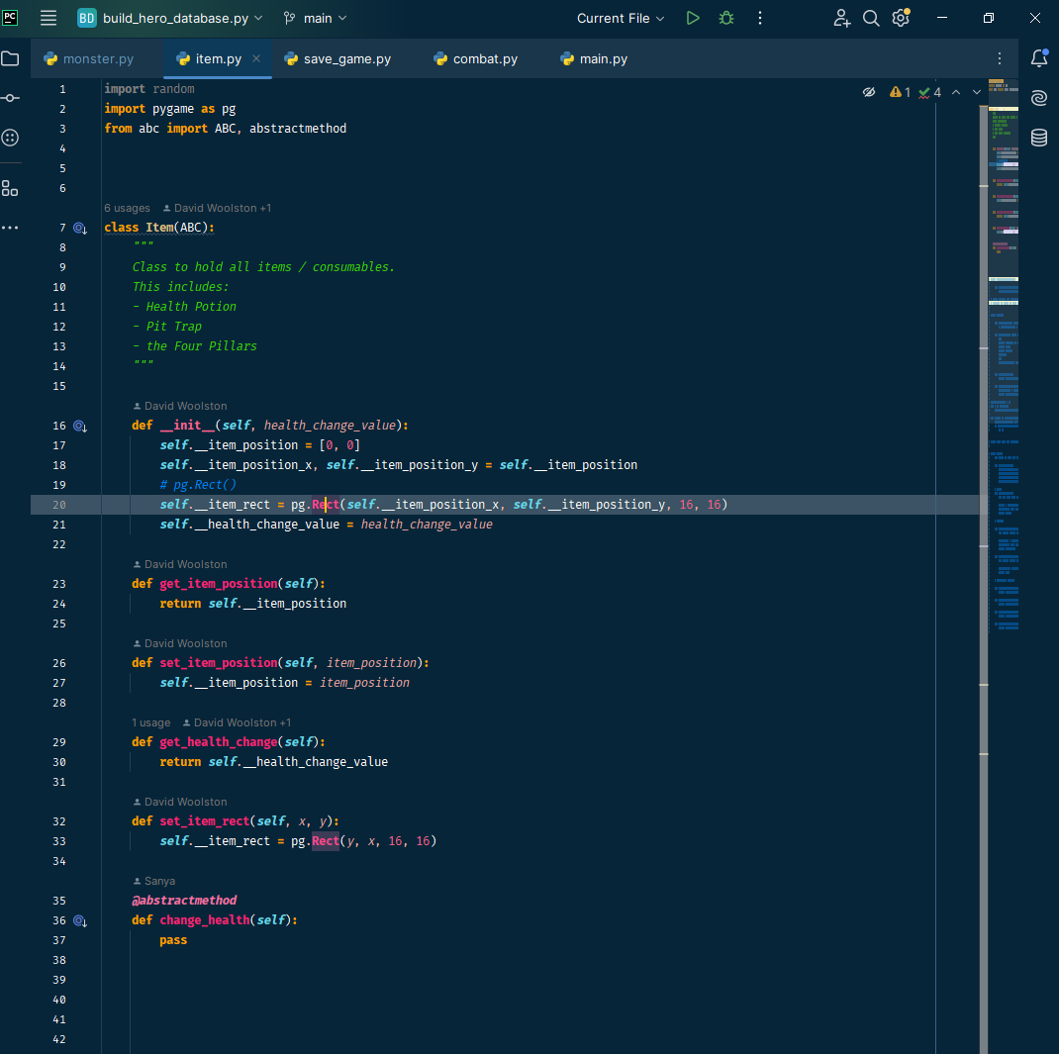
Item ABC

Slide 8
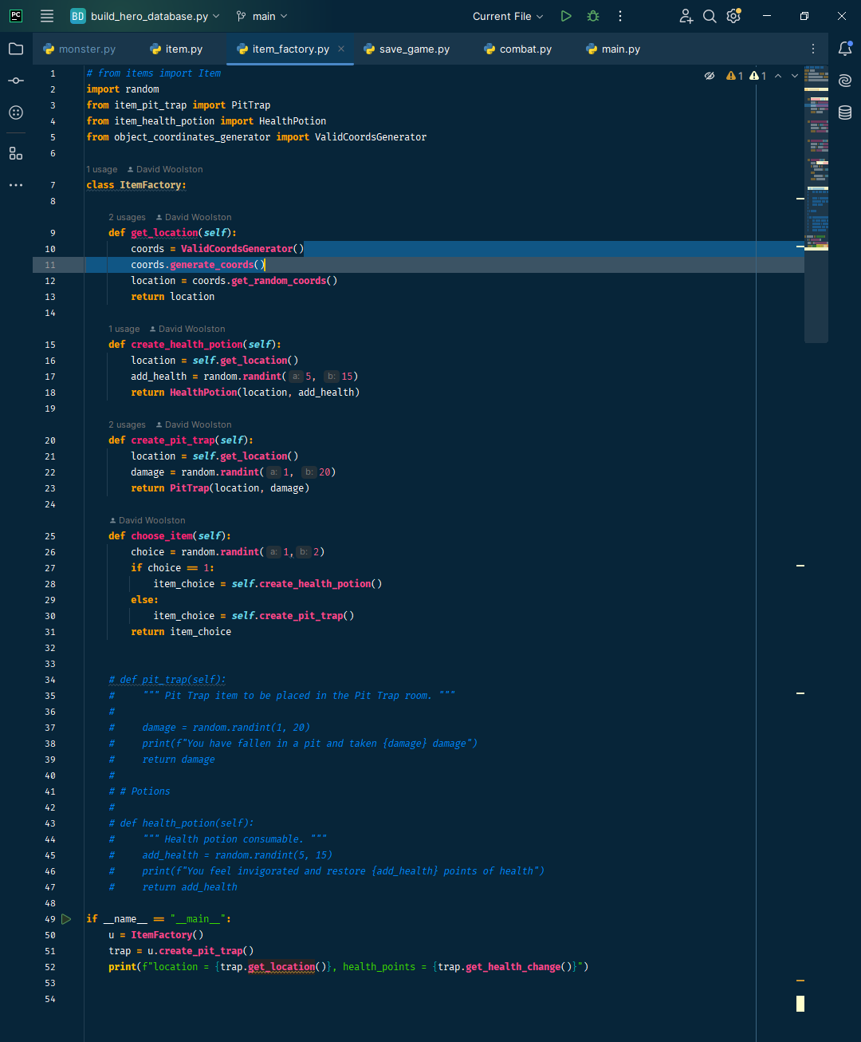
ItemFactory

Slide 9
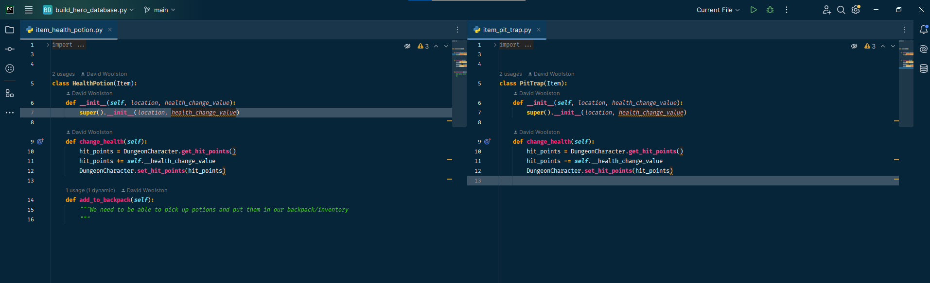
HealthPotion and PitTrap items

Slide 10
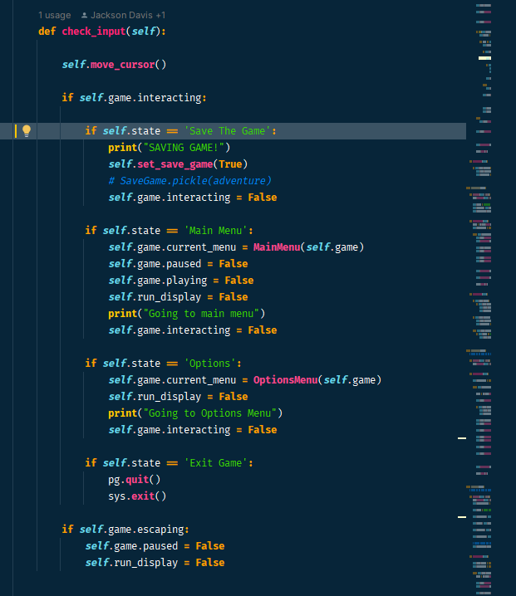
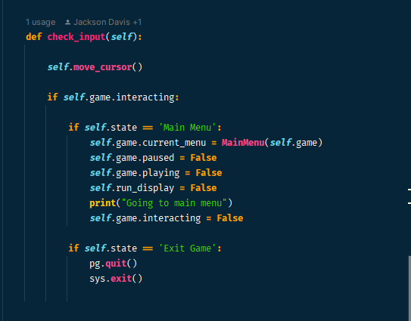
Successful game exit in Menu class

